Slide 1
Core Concepts
Containerization & Orchestration
Kubernetes Architecture & API. Basic Objects and Tools
SoftUni Team
Technical Trainers
Software University
https://about.softuni.bg

Slide 2
Have a Question?
sli.do
#Kubernetes
https://www.facebook.com/groups
/KubernetesOctober2021
Notes:
2

Slide 3
Table of Contents
Containerization and Orchestration
Kubernetes Architecture and API
Basic Tools
Basic Objects
3
Notes:
3

Slide 4

Containerization
Notes:
4

Slide 5
Containerization
“
OS-level virtualization refers to an operating system paradigm in which the kernel allows the existence of multiple isolated user space instances known as containers, zones, jails, …
”
https://en.wikipedia.org/wiki/OS-level_virtualization

Slide 6
Virtual Machines vs Containers
Virtual Machines
VMs virtualize the hardware
Complete isolation
Complete OS installation
Require more resources
Run almost any OS
Containers
Containers virtualize the OS
Lightweight isolation
Shared kernel
Require fewer resources
Run on the same OS
…

Slide 7
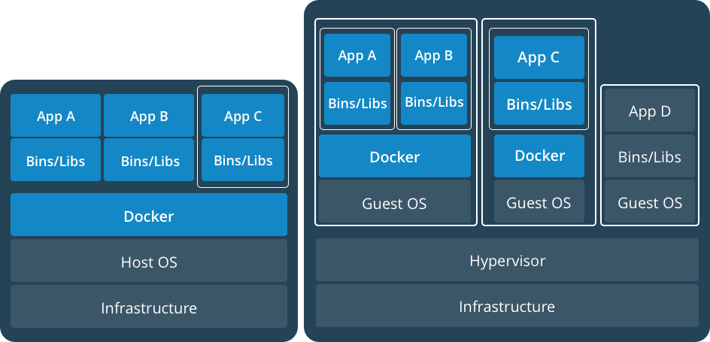
Virtual Machines and Containers
https://www.docker.com/what-container

Slide 8
Definitions
Container
A runnable instance of an image. Containers are processes with much more isolation
Image
A read-only template of a container built from layers. Images provide a way for simpler software distribution
Repository
A collection of different versions of an image identified by tags
Registry
A collection of repositories
Writable Layer
a
bb
Volume
/1.txt
/2.txt
NGINX
bb
Image
/2.txt
Layers
Ubuntu
a
b
/1.txt
/2.txt
Container

Slide 9
Orchestration
Notes:
9

Slide 10
Application Evolution *
Monolithic Applications
Microservices
Containers
Application
Client
MS5
CMS5
CMS4
CMS4
MS4
MS4
Server
CMS1
CMS1
CMS1
CMS2
CMS3
MS1
MS1
CDB1
CDB2
CDB3
MS1
MS2
MS3
Host 1
Single Container Host
Host 2
Host 3
Database
Database
DB1
DB2
DB3
Microservices != Containers
Notes:
10

Slide 11
New Demands*
Workload deployment and distribution
Resource governance
Scalability and availability
Automatization and management
Internal and external communication
Container Orchestration
* Not an exhaustive list

Slide 12
Kubernetes Got You Covered*
Runs a cluster of hosts
Schedules containers to run on different hosts
Facilitates the communication between the containers
Provides and controls access to/from outside world
Tracks and optimizes the resource usage
* Not an exhaustive list

Slide 13
Kubernetes Origin
Born out of projects like Borg and Omega at Google
Written in Go
Donated to CNCF in 2014
Open source, licensed under Apache 2.0
Version 1.0 came into existence in July 2015. Current is 1.22.2
κυβερνήτης in Greek means Helmsman – s.o. who steers the ship
Can be seen often as k8s
8
(Kubernetes)
(Kubernetes)

Slide 14
Other Solutions*
Docker Swarm
HashiCorp Nomad
Apache Mesos + Marathon
* Not an exhaustive list

Slide 15
Kubernetes Architecture
Notes:
15

Slide 16
Architecture Overview *
Kubernetes Cluster
Control Plane Node
Control Plane Node
Node 1
Node 2
Control Plane Node
Pod 1
Pod 1
Proxy
Proxy
Scheduler
Kubelet
Pod n
Kubelet
Pod n
Controller
Node 3
Node 4
API Server
Pod 1
Pod 1
Proxy
Proxy
Persistent Store
Kubelet
Pod n
Kubelet
Pod n
* Not all components are shown

Slide 17
Control Plane (master) Nodes
Responsible for managing the cluster
Typically, more than one is installed
In HA mode one node is the Leader
It is work-free (this can be changed)
Components running on master are also known as Control Plane
Can be reached via CLI (kubectl), APIs, or Dashboard
Control Plane Node
Scheduler
Controller
API Server
Persistent Store

Slide 18
Control Plane Nodes: Persistent Store
Based on etcd
Persistent storage
Cluster state and configuration
Distributed and consistent
Provides single source of truth
Can be installed externally
Control Plane Node
Scheduler
Controller
API Server
Persistent Store

Slide 19
Control Plane Nodes: API Server
Exposes the Kubernetes API (REST)
Front-end for the control plane
Administrative tasks
Consumes JSON via Manifest files (YAML)
Control Plane Node
Scheduler
Controller
API Server
Persistent Store

Slide 20
Control Plane Nodes: Controller
Executes control loops
Responsible for other controllers
Node controller
Endpoints controller
Namespace controller, etc.
Watches for changes
Maintains the desired state
Control Plane Node
Scheduler
Controller
API Server
Persistent Store

Slide 21
Control Plane Nodes: Scheduler
Listens API Server for new work
Assigns work to nodes
Control Plane Node
Scheduler
Controller
API Server
Persistent Store

Slide 22
(Worker) Nodes
Container runtime
Docker, containerd, CRI-O, …
kubelet
Communicates with the control plane
kube-proxy
Network proxy
Node 1
kube-proxy
kubelet
Container Runtime
Pod 1
Pod 2

Slide 23
(Worker) Nodes: kubelet
Main Kubernetes agent
Registers node in the cluster
Listens to the API Server
Creates pods
Reports back to the control plane
Exposes endpoint on :10255
/spec
/healthz
/pods
Node 1
kube-proxy
kubelet
Container Runtime
Pod 1
Pod 2

Slide 24
(Worker) Nodes: Container Runtime
Container management:
Pulling images
Starting and stopping
It is pluggable
By default, is Docker
Node 1
kube-proxy
kubelet
Container Runtime
Pod 1
Pod 2

Slide 25
(Worker) Nodes: kube-proxy
Provides the networking
Each pod has its own address
All containers in a pod share the same IP address
Offers load balancing across all pods in a service
Node 1
kube-proxy
kubelet
Container Runtime
Pod 1
Pod 2

Slide 26
Work with Kubernetes
Notes:
26

Slide 27
Kubernetes Distributions
A software package that provides a pre-built version of Kubernetes
Most distributions also offer installation tools or additional software integrations
On-premise
Minikube, MicroK8s, K3s, k0s, openSUSE Kubic, OpenShift, VMware Tanzu …
Cloud-based
Azure Kubernetes Services (AKS), Elastic Container Service for Kubernetes (EKS), Google Kubernetes Engine (GKE), …
Usually, cloud versions are a few versions behind

Slide 28
Installation Scenarios and Tools
Installation methods
Localhost (minikube or kind)
On-Premise (VMs, Bare Metal)
Cloud (Hosted Solutions, Turnkey Solutions, Bare Metal)
Configurations
All-in-One Single Node and different Multi Node options
Installation tools
kubeadm, KubeSpray, KOps

Slide 29
kind
Easiest way to test and start with Kubernetes
kind stands for Kubernetes in Docker
So, it requires Docker to be installed and configured
https://kind.sigs.k8s.io/docs/

Slide 30
minikube
Easiest and recommended way for a local all-in-one cluster
Requirements
kubectl
Hypervisor (VirtualBox, Hyper-V, KVM, xhyve, VMware Fusion)
VT-x/AMD-v enabled
Internet connection on first run
Supports Linux, macOS, and Windows
Provides docker-machine-like experience, but for Kubernetes
https://minikube.sigs.k8s.io/docs/

Slide 31
kubectl
Controls Kubernetes clusters
Expects a file named config in the $HOME/.kube directory
Other files can be specified by setting the KUBECONFIG environment variable or by setting the --kubeconfig flag
The syntax is
kubectl [command] [TYPE] [NAME] [flags]
https://kubernetes.io/docs/reference/kubectl/overview/

Slide 32
kubectl
Where command is the operation (run, get, etc.) and type is the resource (pod, service, etc.). Note that name is case-sensitive
Its version should +/- 1 minor version compared to the cluster. For example, with kubectl version 1.22 we can work with clusters version 1.21, 1.22, and 1.23
https://kubernetes.io/docs/reference/kubectl/overview/

Slide 33
Dashboard
A web-based Kubernetes user interface
Deployment of containerized applications to a cluster
Troubleshooting containerized application
Managing the cluster resources
https://kubernetes.io/docs/tasks/access-application-cluster/web-ui-dashboard/

Slide 34

Practice
Live Exercise in Class (Lab)
Notes:
34

Slide 35
Basic Kubernetes Objects 101
Namespaces. Pods. Services
Notes:
35

Slide 36
Objects Overview
Kubernetes objects are persistent entities
They are used to represent the state of the cluster
An object is a "record of intent". Once created, the Kubernetes system will constantly work to ensure that object exists
Almost every object includes two nested object fields
Spec provides a description of the characteristics (desired state)
Status describes the current state of the object
They include Pods, Services, Namespaces, Volumes, etc.
https://kubernetes.io/docs/concepts/overview/working-with-objects/kubernetes-objects/

Slide 37
Objects Management
Imperative commands
Commands are invoked against live objects. We directly state what should be done. Good for development or test and for one-off tasks
Imperative object configuration
Operations are specified together with at least one file, which contains the definition of target object(s). Can be used in production
Declarative object configuration
Operates with local configuration files but the actions are not stated explicitly. Can work with files and folders
https://kubernetes.io/docs/concepts/overview/working-with-objects/object-management/

Slide 38
Namespaces
Kubernetes supports multiple virtual clusters
These virtual clusters are called namespaces
Namespaces provide a scope for names
Names of resources need to be unique within a namespace
Namespaces cannot be nested inside one another
Each Kubernetes resource can only be in one namespace
Most Kubernetes resources are in some namespace
Namespace resources are not themselves (and others such as nodes) in a namespace
Deleting a Namespace will clean up everything under it
https://kubernetes.io/docs/concepts/overview/working-with-objects/namespaces/

Slide 39
Namespaces vs Clusters vs Data Centers
NS 1
(default)
NS 2
(system)
NS 3
(app1)
NS 1
(default)
NS 2
(system)
Namespaces divide a k8s cluster to virtual clusters
k8s cluster A
k8 cluster B
M1
M2
M3
M4
M5
M6
M7
k8s cluster abstracts the datacenter

Slide 40
Pods (1)
Smallest unit of scheduling
Scheduled on nodes
One or more containers
Containers share the pod environment
Deployed as one and on one node. It is atomic
Created via manifest files
Pod
Environment
…
UTS
IPC
NET
Main container
Supporting containers
Special infra container (pause)
https://kubernetes.io/docs/concepts/workloads/pods/

Slide 41
Pods (2)
Pod 1
Pod 2
localhost
localhost
10.10.20.20
10.10.20.21
Pod Network
Each pod has a unique IP address
Inter-pod communication is via a pod network
Intra-pod communication is via localhost and port

Slide 42
Pod Manifest
apiVersion: v1
kind: Pod
metadata:
name: appa-pod
spec:
containers:
- name: appa-container
image: shekeriev/k8s-appa:v1
ports:
- containerPort: 80

Slide 43
Labels and Annotations
Labels
Key-value pairs attached to objects
Each object may have multiple labels
Each label may be attached to multiple objects
Used to identify and group sets of objects
Used with label selectors to select a group of objects
Annotations
Key-value pairs attached to objects
Used to store additional information (metadata) like description, creator, etc.
Apply to annotations as well

Slide 44
Services
Provide reliable network endpoint
IP address
DNS name
Port
Expose pods to the outside world
Use end point object to track pods
Use label selectors to do their magic
Pod A IP, Pod B IP, Pod C IP, …
IP: 10.10.10.1
DNS: demo-svc
Port: 32001
End Point
Service
Node 1
Node 2
Pod A
Pod C
Pod B
10.10.20.21
10.10.20.23
10.10.20.22
https://kubernetes.io/docs/concepts/services-networking/service/

Slide 45
Service Types
ClusterIP exposes the Service on a cluster-internal IP. This way the Service will be only reachable from within the cluster. This is the default
NodePort exposes the Service on each Node's IP at a static port specified by the NodePort. A ClusterIP Service, to which the NodePort Service routes, is automatically created. We can contact the NodePort Service, from outside the cluster, by requesting <NodeIP>:<NodePort>. Default range is between 30000 and 32767

Slide 46
Service Types
LoadBalancer exposes the Service externally using a cloud provider's load balancer. NodePort and ClusterIP Services, to which the external load balancer routes, are automatically created
ExternalName maps the Service to the contents of the externalName field (e.g. foo.bar.example.com), by returning a CNAME record with its value. No proxying of any kind is set up.

Slide 47
Service Manifest
apiVersion: v1
kind: Service
metadata:
name: appa-svc
labels:
app: appa
spec:
type: NodePort
ports:
- port: 80
nodePort: 30001
protocol: TCP
selector:
app: appa

Slide 48
Services in Action
Service
app = myapp
version = v01
Pod
app = myapp
version = v01
Initial deployment – one pod with version = v01

Slide 49
Services in Action (Scale Up)
Service
app = myapp
version = v01
Pod
Pod
Pod
app = myapp
app = myapp
app = myapp
version = v01
version = v01
version = v01
Scale up – two more pods with version = v01

Slide 50
Services in Action (Scale Down)
Service
app = myapp
version = v01
Pod
Pod
app = myapp
app = myapp
version = v01
version = v01
Scale down – remove one pod and end up with two pods with version = v01

Slide 51
Services in Action (App Update)
Service
app = myapp
version = v01
Pod
Pod
Pod
Pod
app = myapp
app = myapp
app = myapp
app = myapp
version = v01
version = v02
version = v02
version = v01
Next step – add two more pods with version = v02

Slide 52
Services in Action (App Update)
Service
app = myapp
version = v02
Pod
Pod
Pod
Pod
app = myapp
app = myapp
app = myapp
app = myapp
version = v01
version = v02
version = v02
version = v01
Next step – we update the service to look for version = v02

Slide 53
Services in Action (App Update)
Service
app = myapp
version = v02
Pod
Pod
app = myapp
app = myapp
version = v02
version = v02
Finally, all pods with version = v01 are destroyed

Slide 54
Practice
Live Exercise in Class (Lab)
Notes:
54

Slide 55
Basic Kubernetes Objects 102
Replication Controllers. Replica Sets. Deployments
Notes:
55

Slide 56
Replication Controllers
Higher level workload
Looks after pod or set of pods
Scale up/down pods
Sets Desired State
Rarely used these days
ReplicationController
Pod
https://kubernetes.io/docs/concepts/workloads/controllers/replicationcontroller/

Slide 57
Replication Controller Manifest
apiVersion: v1
kind: ReplicationController
metadata:
name: appa-rc
spec:
replicas: 3
selector:
app: appa
template:
… [POD definition] …

Slide 58
Replica Sets
Higher level workload
Looks after pod or set of pods
Scale up/down pods
Sets Desired State
Preferred over Replication Controllers
Rarely used alone by itself
ReplicaSet
Pod
https://kubernetes.io/docs/concepts/workloads/controllers/replicaset/

Slide 59
Replica Set Manifest
apiVersion: apps/v1
kind: ReplicaSet
metadata:
name: appa-rs
spec:
replicas: 3
selector:
matchLabels:
app: appa
template:
… [POD definition] …

Slide 60
Deployments
Even higher-level workload
Simplifies updates and rollbacks
Declarative and imperative approach
Self documenting
Suitable for versioning
Deployment
ReplicaSet
Pod
https://kubernetes.io/docs/concepts/workloads/controllers/deployment/

Slide 61
Deployment Manifest
apiVersion: apps/v1
kind: Deployment
metadata:
name: appa-deploy
spec:
replicas: 3
selector:
matchLabels:
app: appa
minReadySeconds: 15 # optional, default 0
strategy: # the whole block can be skipped
type: RollingUpdate # strategy to replace old pods, defaults to RollingUpdate
rollingUpdate:
maxUnavailable: 1 # maximum number of unavailable pods, defaults to 25%
maxSurge: 1 # maximum number of pods that can be created in excess, defaults to 25%
template:
… [POD definition] …

Slide 62
Practice
Live Exercise in Class (Lab)
Notes:
62

Slide 63
Questions?
Notes:
63

Slide 64






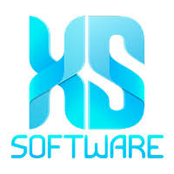


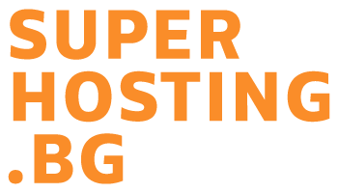
SoftUni Diamond Partners

Slide 65
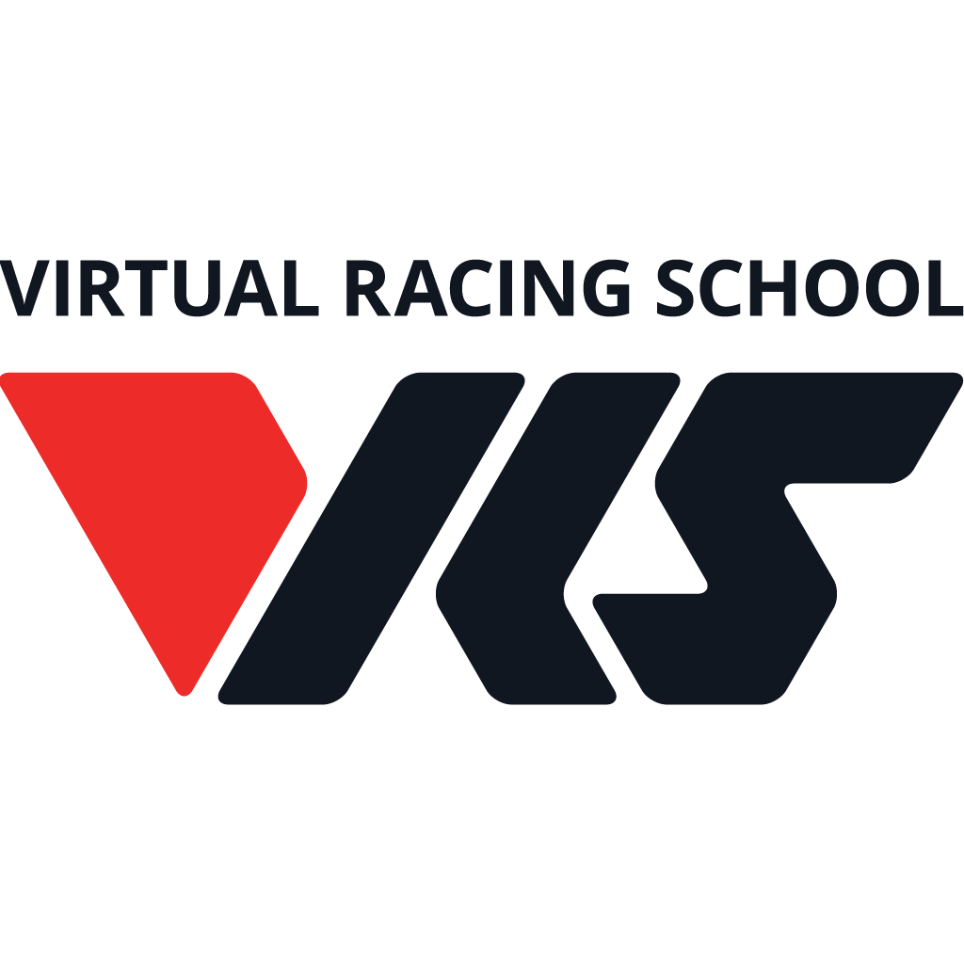

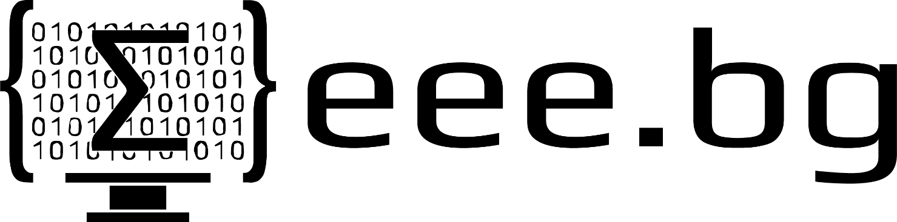
Educational Partners

Slide 66

License
This course (slides, examples, demos, exercises, homework, documents, videos and other assets) is copyrighted content
Unauthorized copy, reproduction or use is illegal
© SoftUni – https://about.softuni.bg/
© Software University – https://softuni.bg
Notes:
66

Slide 67
Trainings @ Software University (SoftUni)
Software University – High-Quality Education, Profession and Job for Software Developers
softuni.bg, about.softuni.bg
Software University Foundation
softuni.foundation
Software University @ Facebook
facebook.com/SoftwareUniversity
Software University Forums
forum.softuni.bg
Notes:
67

